Slide 1
The Biochemical effects of Lead exposure in the skeleton
Eric E. Beier, Ph.D.
Toxicologist at the U.S Food & Drug Administration
Center for Musculoskeletal Research
Departments of Orthopedics and Environmental Medicine
University of Rochester, Rochester, NY
Notes:
Lead Decreases Bone Mass and Bone Strength through Inhibition of Wnt Signaling

Slide 2
Disclaimer
This presentation reflects the views of the author and should not be construed to represent FDA’s views or policies

Slide 3
Presentation Outline
Background and Significance
  Pb, bone disease, and relevant signaling pathways
  Characterization of Pb effects on skeletal biology
Hypothesis
Experimental Aims 1
  Pb inhibits Wnt signaling through a sclerostin-dependent mechanism
Experimental Aims 2
  Implications of depressed Wnt signaling by Pb on bone processes
Summary

Slide 4
Lead is a Pervasive Environmental Toxicant
Pb exposure remains a public health concern
  Paint, gas pollution, food contamination, industrial use
CDC Guidelines: policies regarding adverse Pb intoxication is set at 5 µg/dl blood Pb level
A NOAEL for Pb has yet to be identified in humans
Lead has detrimental effects in several organ systems
  Brain, kidney, heart, bone
60
30
25
10
5
2?

Slide 5
Elevated Blood Lead May Have a Causative Role in Decreased Bone Mass
Pb alters early bone growth and bone accrual
  Ronis et al. (2001) Skeletal effects of developmental lead exposure in rats. Toxicol Sci, 62(2): p. 321-9.
  Kafourou et al. (1997) Effects of lead on the somatic growth of children. Arch Environ Health, 52(5): p. 377-83.
  Beier et al. (2013) Heavy Metal Lead Exposure, Osteoporotic-like Phenotype in an Animal Model, and Depression of Wnt Signaling. Environ Health Perspect, 121(1): p.97-104.
NHANES : significant inverse association between BLL and BMD in vertebrae and femur
  Nash et al. (2004) Bone density-related predictors of blood lead level among peri- and postmenopausal women in the United States. Am J Epidemiol, 160(9): p. 901-11.
  Potula et al. (2006) Lead exposure and spine bone mineral density. J Occup Environ Med, 48(6): p. 556-64.
Pb is associated with increased fractures, decreased healing, and decreased hip BMD
  Khalil et al. (2008) Relationship of BLLs to incident nonspine fractures and falls in older women. J Bone Miner Res, 23(9): p. 1417-25.
  Carmouche et al. (2005) Lead exposure inhibits fracture healing and is associated with increased chondrogenesis, delay in cartilage mineralization, and a decrease in osteoprogenitor frequency. Environ Health Perspect, 113(6): p. 749-55.
  Beier et al. (2014) Inhibition of beta-cateninsignaling by Pb leads to incomplete fracture healing. J Orthop Res, 32(11): p. 1397-1405
Notes:
Doesn’t reach peak bone mass
Osteoporosis is a prevalent skeletal disorder characterized by compromised bone strength and consequent increased risk of fractures. Postmenopausal women are at higher risk for developing osteoporosis and osteoporosis-related fractures. There are multiple etiologies for this complex metabolic bone disease, and, with the exception of osteoporosis-pseudoglioma syndrome due to mutations in LRP5 (9), it is unknown whether Wnt signaling plays a role. Interestingly, dexamethasone increases expression of Dkk1 and sFRP1 and represses Wnt/β-catenin signaling in human osteoblasts, suggesting a role for this pathway in glucocorticoid-induced osteoporosis (70–72). Further mechanistic work in human osteoporosis will be important to fully understand the relevance of Wnt signaling pathways in this disease.

Slide 6
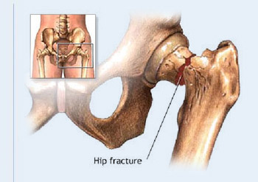
Societal Burden of Osteoporosis
Estimated cost associated with OP fracture $17-20 billion (2010)
Roughly 8.9 million fragility fractures annually
Occurance: 1 in 3 women, 1 in 5 men over age 50
Increases morbidity and mortality among the elderly
International Osteoporosis Foundation
Notes:
The majority of this cost is spent on the acute surgical and medical management following hip fracture, and the subsequent rehabilitation
8.9 million fractures annually, including hip, vertebral (spinal), wrist, and other fractures
Importantly, activation of Wnt/β-catenin signaling also inhibits adipogenesis of mesenchymal precursors (30, 31), which may have clinical importance given the positive correlation reported between marrow adipose content and bone fractures (32).
v“silent epidemic”

Slide 7
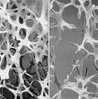
Characteristics of Osteoporosis
2.5 SD below peak average BMD
OP fractures occur in areas with relatively high trabecular bone to cortical bone ratio
Imbalance in bone coupling (resorption > formation)
Erosion of trabecular
micro-architecture
Pei-Yang, L. et al. (2011)
Notes:
Osteoporosis is a prevalent skeletal disorder characterized by compromised bone strength and consequent increased risk of fractures.
Importantly, activation of Wnt/β-catenin signaling also inhibits adipogenesis of mesenchymal precursors (30, 31), which may have clinical importance given the positive correlation reported between marrow adipose content and bone fractures (32).

Slide 8
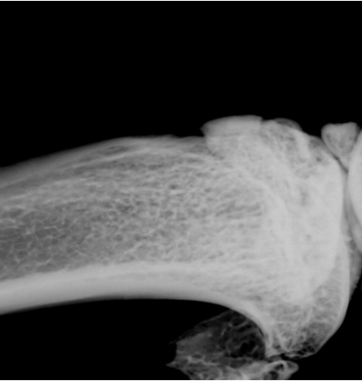
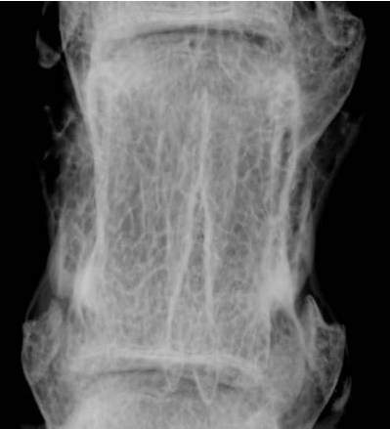
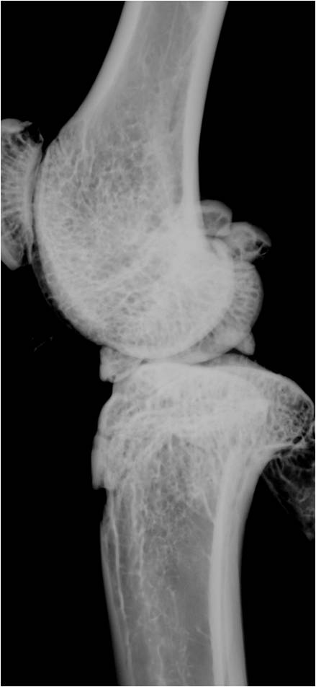
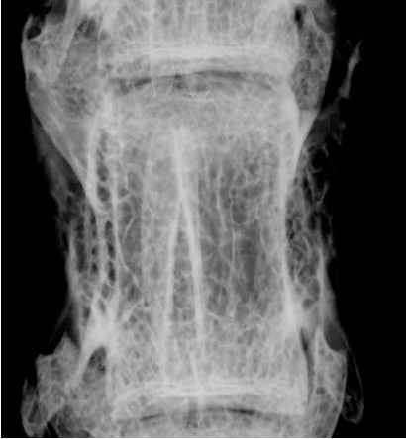


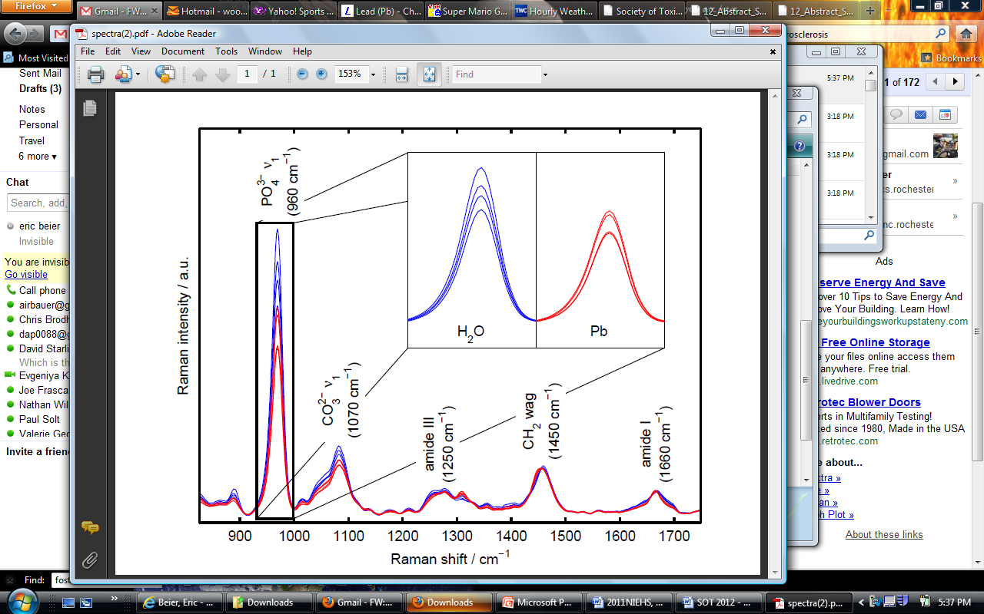
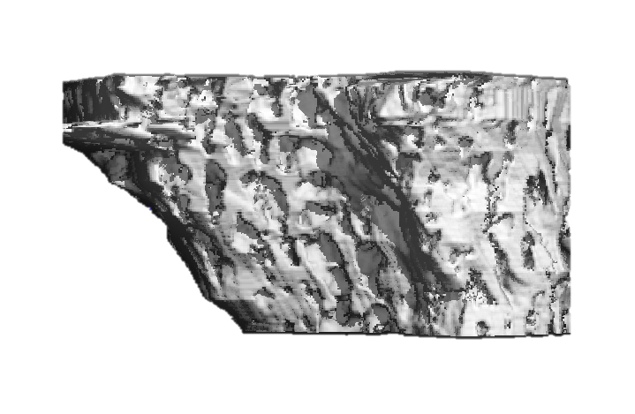
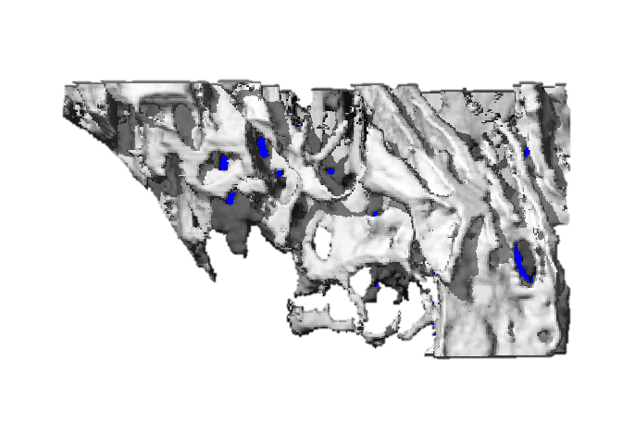
Chronic Lead Exposure Produces Bone Loss in Rats
Beier (2013) Environ Health Perspect
Control
Pb-exposed
Max Force (N) | Control | Pb-exposed
Compress | 280.7 ± 30.9 | 181.6 ± 21.1
Bending | 264.4 ± 10.1 | 204.6 ± 17.5
Blood (µg/dl)
0.19
9.16
Bone (ng/mg)
0.17
30.99
A
B
*
C
D
Pb-exposed
C
D
Control
Ctrl
F
Tb.BV/TV
Tb.N
Tb.Sp
*
*
*
Control
Pb-exposed
Notes:
Doesn’t reach peak bone mass
Osteoporosis is a prevalent skeletal disorder characterized by compromised bone strength and consequent increased risk of fractures. Postmenopausal women are at higher risk for developing osteoporosis and osteoporosis-related fractures. There are multiple etiologies for this complex metabolic bone disease, and, with the exception of osteoporosis-pseudoglioma syndrome due to mutations in LRP5 (9), it is unknown whether Wnt signaling plays a role. Interestingly, dexamethasone increases expression of Dkk1 and sFRP1 and represses Wnt/β-catenin signaling in human osteoblasts, suggesting a role for this pathway in glucocorticoid-induced osteoporosis (70–72). Further mechanistic work in human osteoporosis will be important to fully understand the relevance of Wnt signaling pathways in this disease.

Slide 9
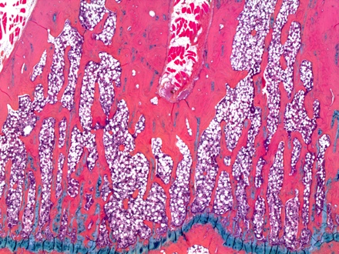
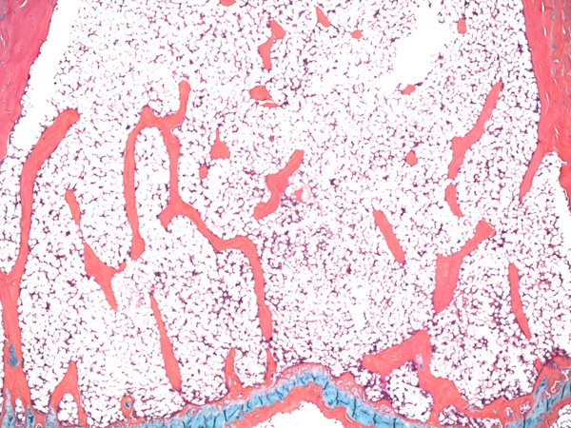
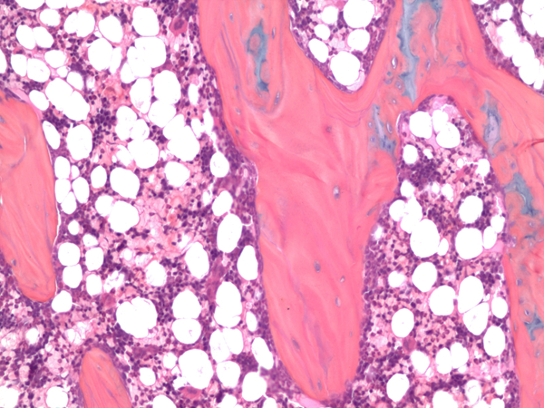
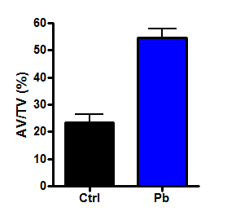
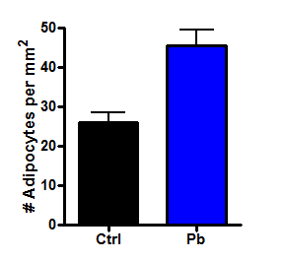
Bone Formation and Adipogenic Parameters are altered in Pb-treated Rats
Beier (2013) Environ Health Perspect
Control
Pb-exposed
Tb.BV/TV (%)
32.0 ± 3.6
17.6 ± 1.9*
# Ob/Tb.S (mm⁻¹)
184.8 ± 9.6
155.3 ± 5.5*
# Oc/Tb.S (mm⁻¹)
115.4 ± 7.7
138.1 ± 9.9
*
*
Oc.S/BS (%)
16.7 ± 0.7
17.2 ± 0.4
n = 3
*p < 0.05

Slide 10
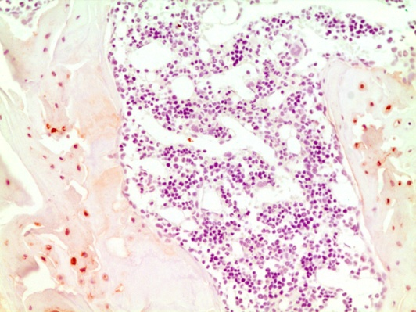
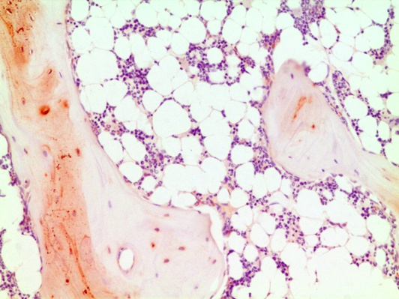
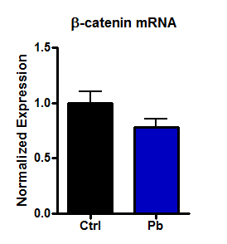
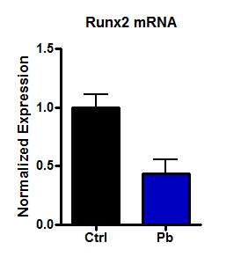
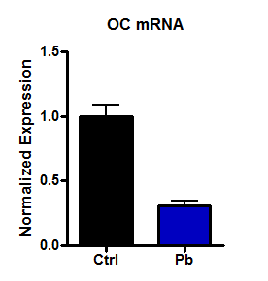
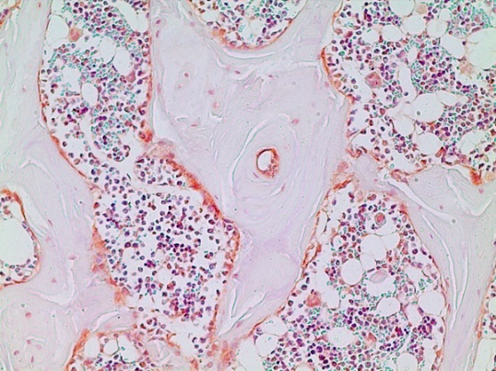
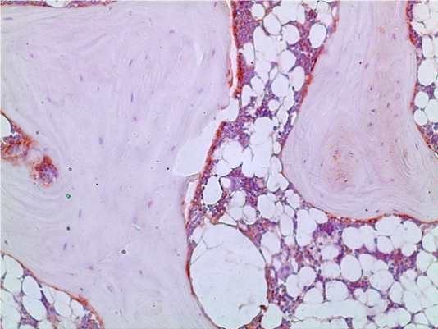
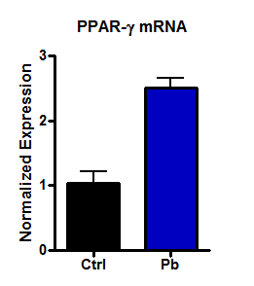
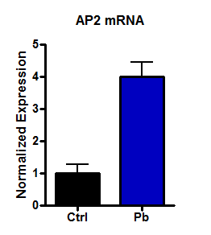
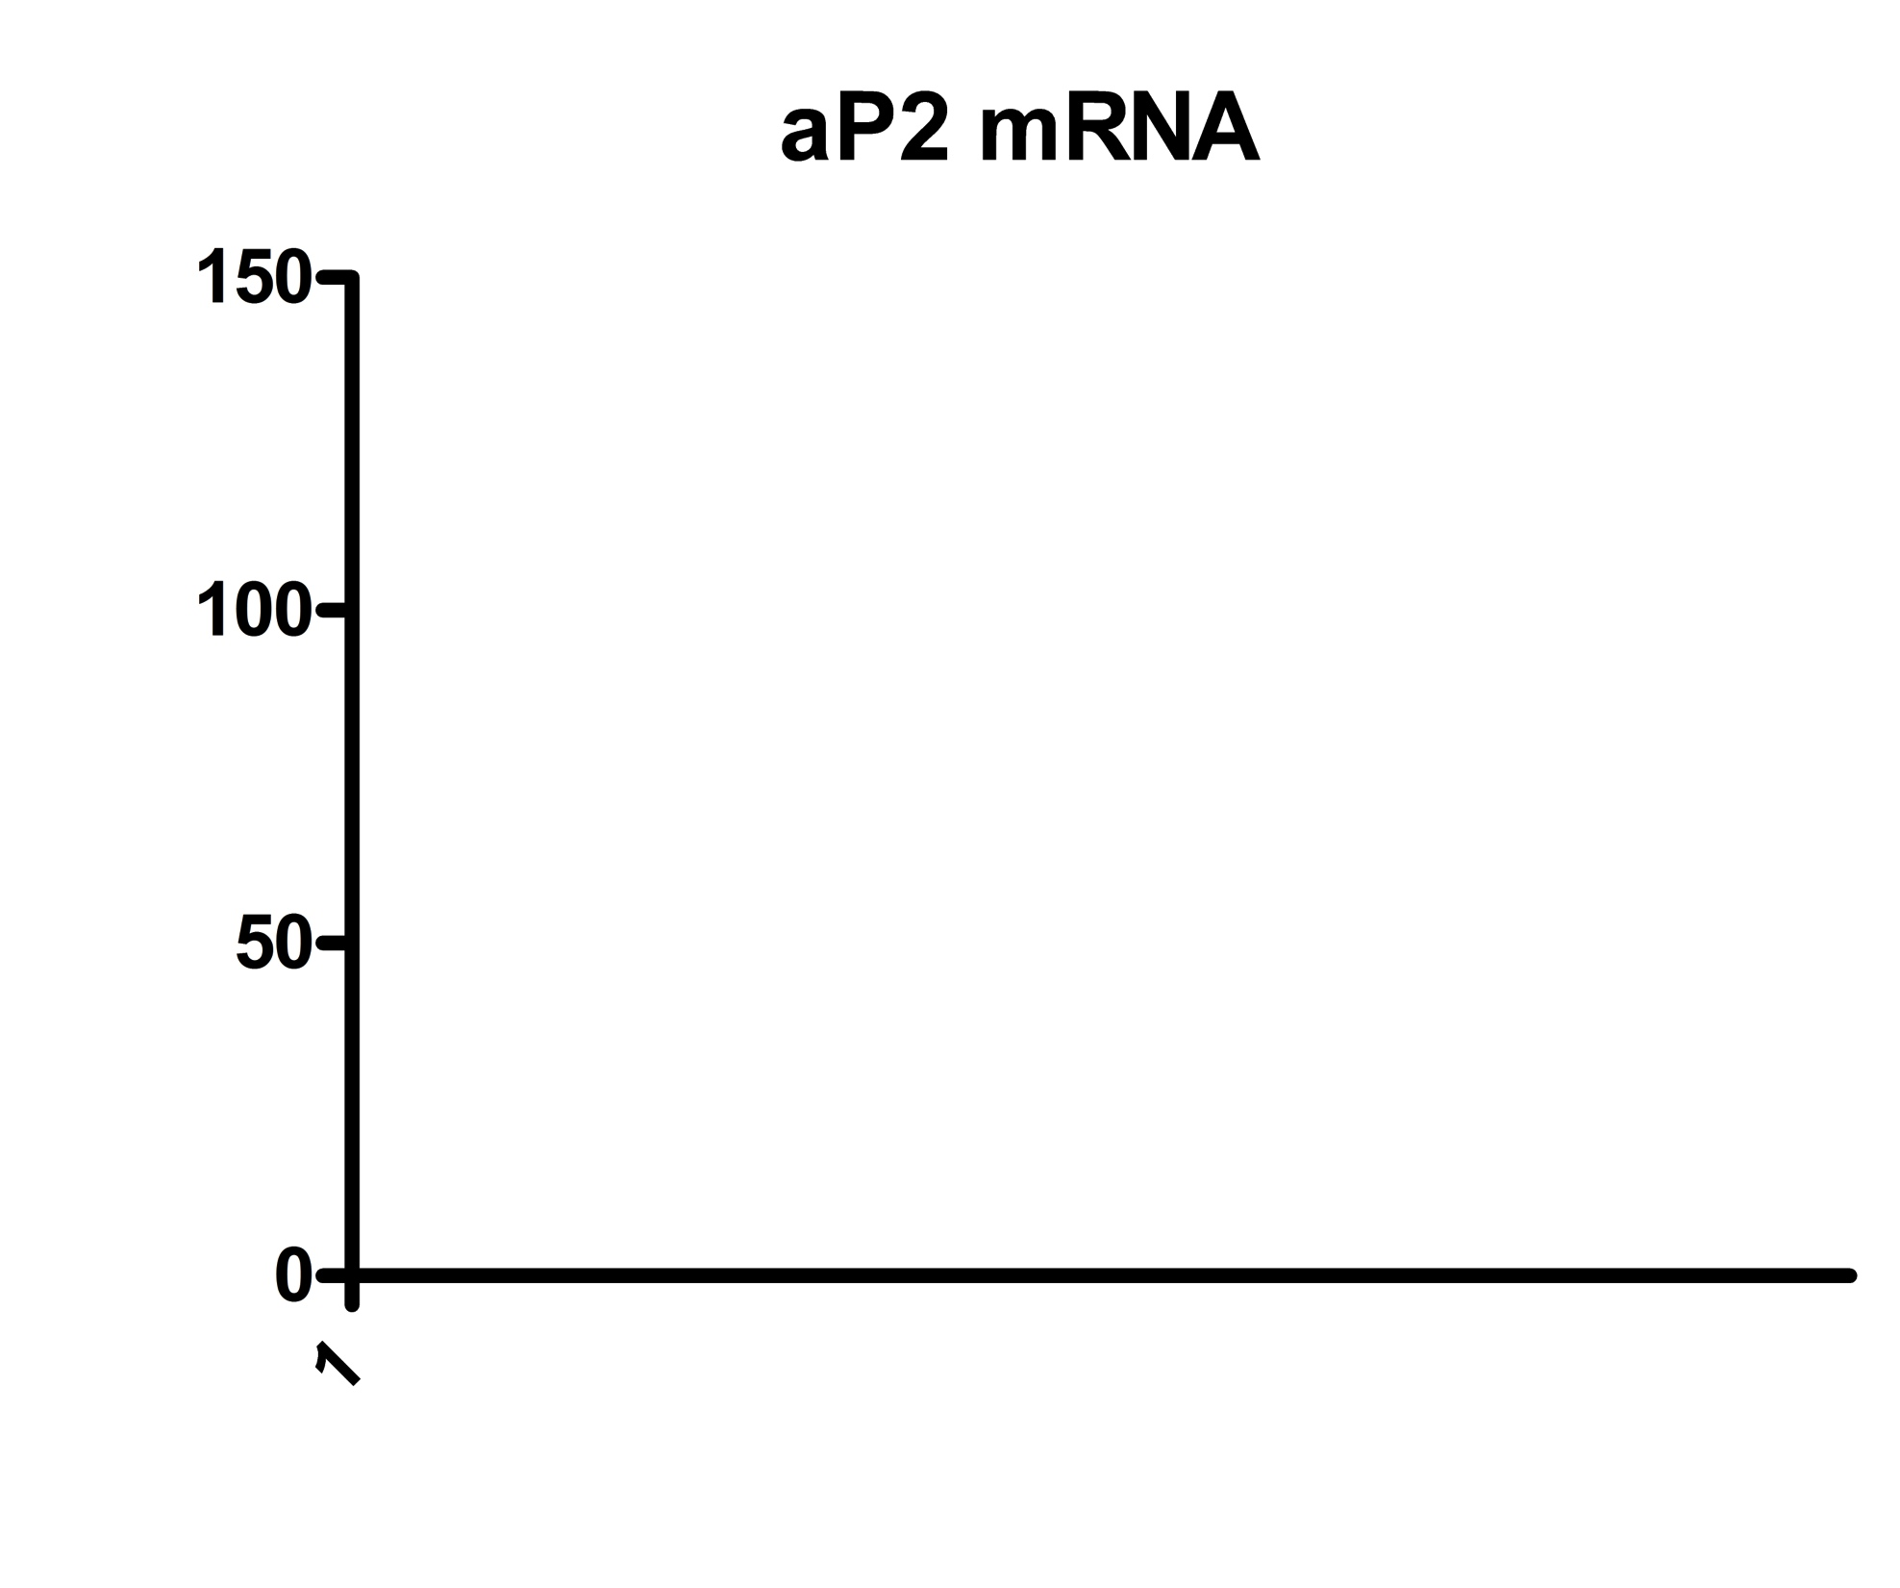
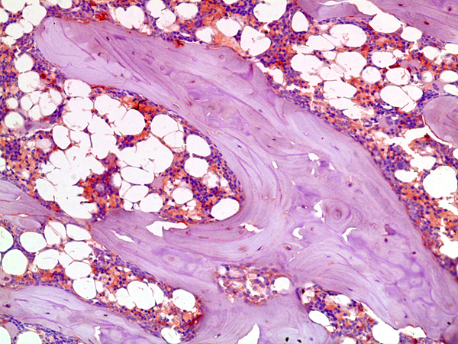
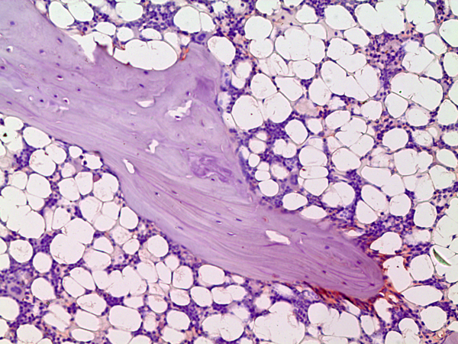
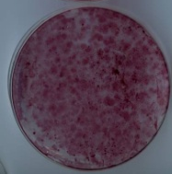
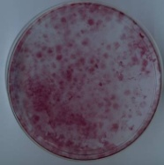
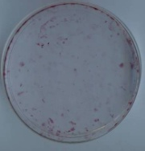
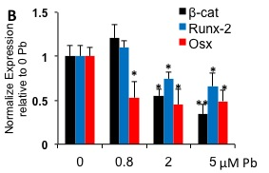
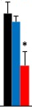
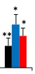
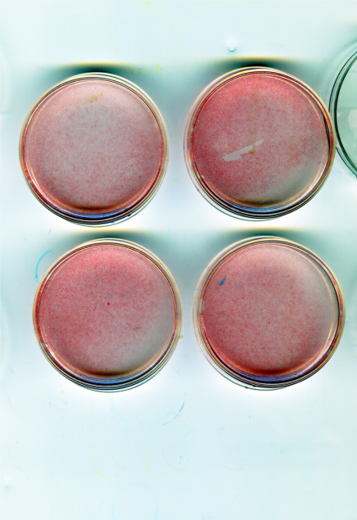
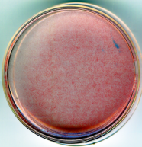

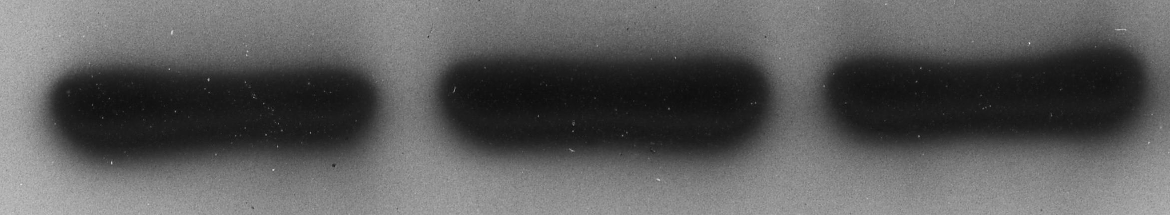
Lead Increases Adipogenic Potential of MSC and Suppresses Osteoblast Differentiation
Control
Pb-exposed
Beier (2013) Environ Health Perspect
A
B
G
*
*
**
Sclerostin
C
D
β-catenin
H
*
**
E
F
Runx2
I
O µM 1 µM 5 µM Pb
J
0 1 5
µM Pb
Alizarin
red
β-catenin
Runx-2
Col1
Oil Red O
Scl
β-actin
*p < 0.05
**p < 0.005
1
5 μM

Slide 11

Agonists and Antagonists in the Canonical WNT Signaling Pathway
Wif-1
Wnt
DKK
Sclerostin
Frizzled
sFRP
LRP5/6
Frizzled
Wnt
LRP5/6
dsh
Axin
dsh
P
GSK-3β
GSK-3β
Axin
APC
β
-catenin
P
β
-catenin
APC
P
LEF
TCF
TCF
β
-catenin
LEF
Genes for bone formation: c-myc
AP-1
cyclin D1
OPG
OFF
ON
Notes:
CBP, gouche repress genes when beta-catenin is being degraded. Chibby binds to beta-catenin in the nucleus
secreted Frizzled-Related Protein 1 (sFRP), WIF-1, Cerberus inhibit Wnts
DKK, Wise, sclerostin, CTGF antagonize LRP5 signaling leaving non-canonical wnt active. DKK can cause endocytosis through Kremen.
**non-canonical Wnt/Ca⁺² (PKC, CamKII, calcineurin) and PCP pathways (Rho, JNK)

Slide 12
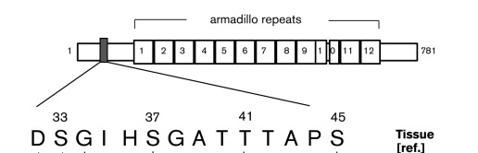
Possible Molecular Interaction of Lead and WNT Signaling
Disruption of protein phosphorylation (Verheyen et al., 2010)
  disheveled
  β-catenin
  APC
Oxidative stress inhibits Wnt through FOX-O signaling competition with β-catenin (Hoogeboom et al., 2008)
Reduction of agonist levels (Wnts)
Induction of antagonists (Scl, DKK, sFRP, Wif-1)
Polakis (1999) Genetics & Devel
Notes:
No publications looking at Pb and Wnt, surprising given the presence of Pb in bone and the importance of Wnt to bone.

Slide 13

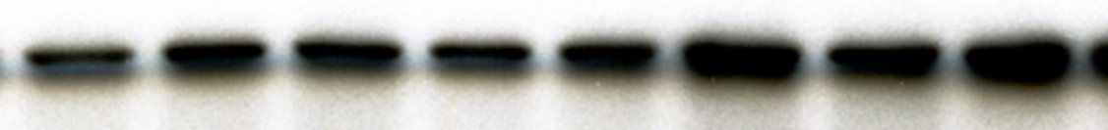
Sclerostin is Upregulated in 2T3 Cells Following Lead Exposure
Beier (2014) J Bone Min Res
*
*
2. Protein Levels
0
1
5 µM Pb
*
*
Scl
*
*
β-actin
μM Pb
n = 3
*p < 0.05

Slide 14
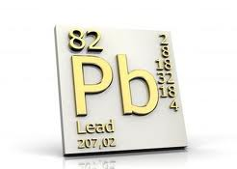
Central Hypotheses
Bone loss is mediated by disruption of bone progenitor cells
Marked by suppression of osteoblast function and augmentation of adipocyte formation
This modulation of stem cell bifurcation occurs through antagonizing β-catenin signaling in a sclerostin-dependent manner

Slide 15
Specific Experimental Aims
Aim 1: Delineate the site of Pb action on β-catenin signaling
Aim 2: Determine whether mice absent of the SOST gene are resistant to the negative effects of Pb on bone quality and strength
Aim 3: Examine whether disruption of Wnt signaling by Pb alters fracture healing

Slide 16
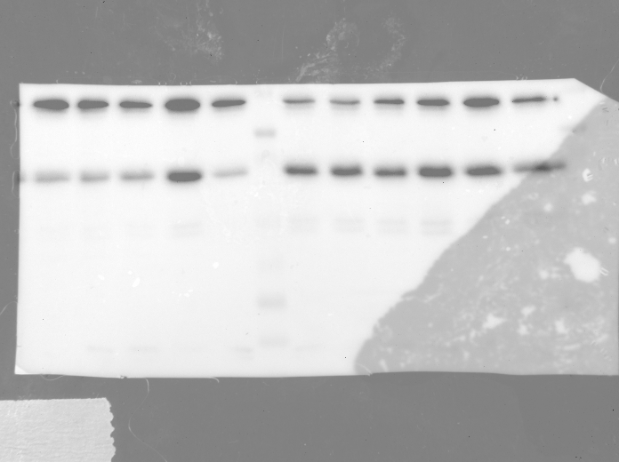
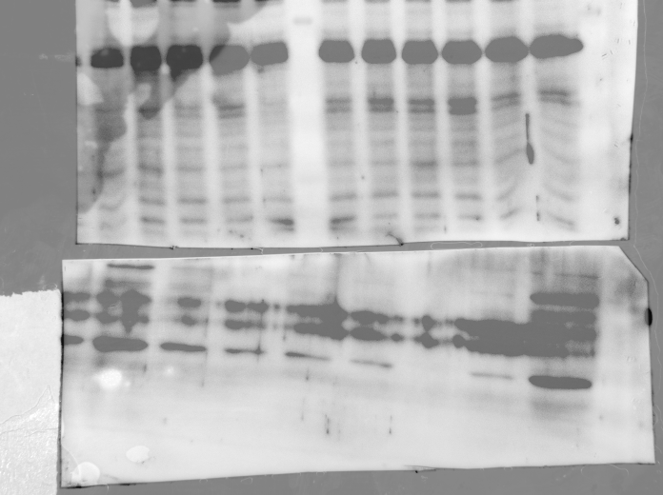
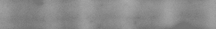
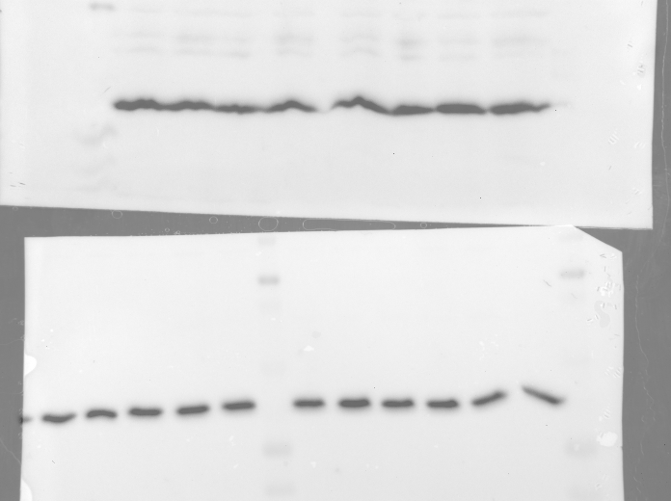
Lead Inhibits WNT Signaling by Enhancing Sclerostin Levels in Osteoblasts
Beier (2014) J Bone Min Res
0
0
0.8
2
5
µM Pb
-
+
+
+
+
75 ng/mL Wnt 3a
Active
β-catenin
Scl
DKK-1
β-Actin
48hr
12hr
Pretreat
Wnt3a
Protein
harvest
n = 3

Slide 17
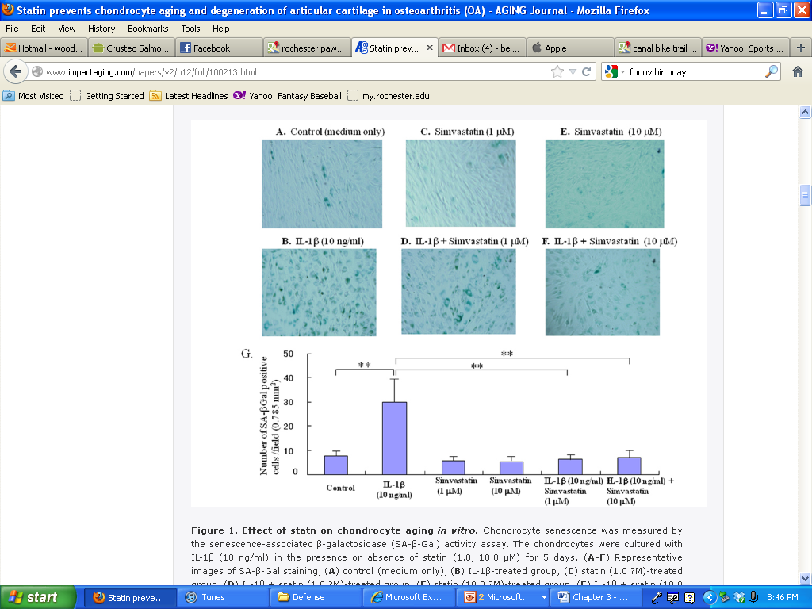
β-catenin Activation in TOPgal Mice with BIO is Unaltered by Lead
Beier (2014) J Bone Min Res
A
0-Pb
5-Pb
B
*
#
#
75 ng/mL Wnt
1 μM BIO
*
#
C
*
*
n = 3
*p < 0.05
#p < 0.05
μM Pb

Slide 18
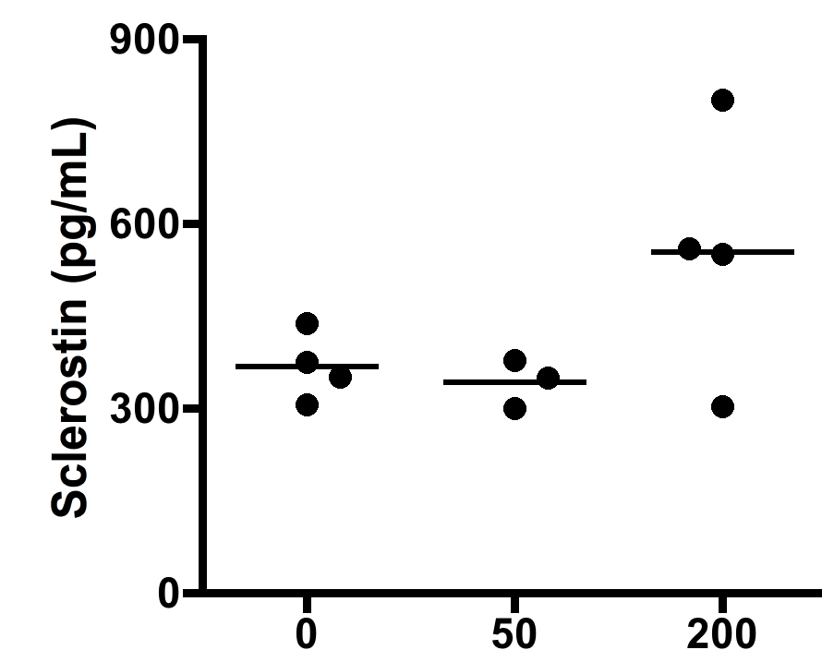
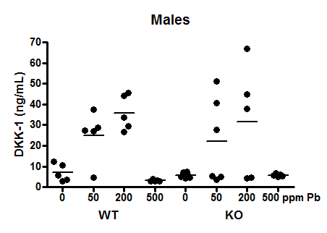
Lead Exposure Increases WNT Antagonists in SOST-KO Mouse Serum
Beier (2014) J Bone Min Res
A
*
B
#
**
#
*
n = 4
*p < 0.05
**p < 0.005
#p < 0.05

Slide 19
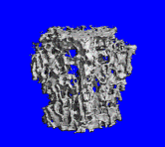
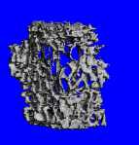
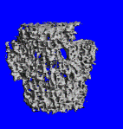
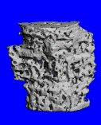
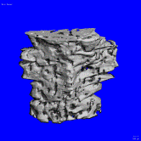
Pb-induced Deficits in Bone Quality is Improved in Lumbar Vertebrae of Sclerostin Null Mice
Beier (2014) J Bone Min Res
0 Pb
50 Pb
200 Pb
WT
KO
BV/TV
(%)
Tb Number
(1/mm)
Tb Spacing
(cm)
0 ppm Pb
34.2 ± 3.7
6.0 ± 0.3
1.7 ± 0.10
50 ppm Pb
23.7 ± 4.1*
5.1 ± 0.2*
2.0 ± 0.07*
WT
200 ppm Pb
25.6 ± 5.8*
5.4 ± 0.1
1.8 ± 0.05
0 ppm Pb
58.3 ± 7.5*
7.8 ± 0.3**
1.2 ± 0.09**
50 ppm Pb
46.4 ± 4.4
7.1 ± 0.6
1.3 ± 0.10
KO
200 ppm Pb
43.6 ± 3.2
7.8 ± 0.1
1.1 ± 0.01
Mean ± SE for 5 mice/group. : *p < 0.05, **p < 0.005 compared to 0 ppm Pb WT
Notes:
Effect of Pb dosing on bone volume and quality in female spine of SOST mice

Slide 20
Bone Strength is Reduced in Pb-exposed WT Mice; Removal of SOST is Resistant to these Deficits
Beier (2014) J Bone Min Res
Compression testing was applied to mouse LV4 and resistance to force was calculated in 6 month-old mice.
n = 5. *p < 0.05. **p < 0.005 vs 0 Pb WT, #p < 0.05 vs 0 Pb KO.

Slide 21
Summary of Part 1
Activation of β-catenin is blunted by conditioned Pb treatment, and corresponds with elevated sclerostin.
Site of Pb action is primarily upstream of β-catenin activation comparing Wnt3a- vs BIO-stimulation.
SOST null mice were more resistant to Pb-induced decrease in bone mass.
Overactive Wnt signaling resulted in stronger bones that were unaffected by elevated Pb treatment.

Slide 22
Experimental Outline
Mice given Pb-acetate treated water for 6 weeks
Closed tibia fracture
IP administration of oil (5% DMSO) or 0.5 mg/kg BIO
  3 days/wk starting at day 1 post fracture
Tibia harvest – x-ray, µCT, histology, mRNA
Fracture
d7
d10
d14
d21
6 weeks
0 or 230 Pb

Slide 23




β-Catenin Activation in TOPGAL Mice with BIO is Unaltered by Lead
Beier (2014) J Orthop Res
Vehicle
1 mg/kg BIO
0 ppm Pb
300 ppm Pb
Vehicle
BIO
Pb
Pb + BIO
N.Ob/Tb.Ar (mm⁻¹)
148.9 ± 11.3
151.2 ± 17.3
128.5 ± 19.9
136.1 ± 14.5
Ob+/Tb.Ar (mm⁻¹)
27.7 ± 0.7
57.2 ± 1.8**
11.6 ± 1.2*
42.0 ± 1.7#
Ob+/Tt.Ob (%)
18.6 ± 0.6
37.8 ± 0.9**
9.1 ± 0.5*
30.8 ± 0.8
Mean ± SE for 3 mice/group.
*p < 0.05, **p < 0.005 compared to vehicle and #p < 0.05 compared to BIO.

Slide 24




















Callus Formation was Decreased in Pb-exposed Mice and Restored by Addition of BIO
Beier (2014) J Orthop Res
A
Day 0
Day 14
Day 21
B
H₂O
BIO
Pb
Pb+ BIO
H₂O
Day 7
BIO
Day 14
C
Pb
#
*
*
Pb + BIO
n=3
*,# p<0.05
Notes:
EP 386 – H20, EP 393 – BIO, EP 398 – Pb, EP 405 – Pb+BIO

Slide 25








Activation of β-Catenin Improves Lead Inhibition of Fracture Healing
Beier (2014) J Orthop Res
A
H₂O
BIO
Pb
Pb+BIO
Day 10
B
#
#
*
*
*
Histomorphometry
C
H₂O
BIO
Pb
Pb+BIO
β-catenin

Slide 26







Downstream WNT Activation Rescues the Lead Inhibition of Cartilage Maturation
Beier (2014) J Orthop Res
A
#
B
*
C
*
#
*
*
D
*
E
*
F
#
#
*
*
Veh
BIO

Slide 27
Summary of Part 2
Delays in endochondral ossification following Pb exposure is restored with concurrent activation of β-catenin.
Further evidence that inhibition of Pb on Wnt signaling is primarily upstream of β-catenin activation as delineated by stimulation with BIO.
Pb produces significant alteration of genes identified to be relevant for bone healing, potential unrelated to Wnt signal.

Slide 28




Model for Lead Effects on Bone Homeostasis
Runx2
Osx
+
Dkk,
Scl
Wnt
Pb
osteoblasts
MSC
-
mesenchymal
stem cells
PPARγ
C/EBPs
-
OPG/RANKL
adipocytes
induction
monocytes
inhibition
osteoclasts
Pb effect

Slide 29




Ongoing Investigations
Pb+ HFD
Pb+ cortisol
Pb+ osteoarthritis
Pb+ bone resorption
*
*
#
#
0-Pb
50-Pb
Beier (2015) Environ Health Perspect
Beier (2017) Bone Res
Holz, Beier (2012) J Ortho Res
Beier (2015) Toxicol Sci

Slide 30
Funding Sources
National Institute of Health
  T32 AR053459, P30 ES0124
Center for Musculoskeletal Research Training Grant
  T32 ES07026
Dr. J Edward Puzas Lab at Univ of Rochester
Tzong-Jen Sheu, Ph.D
Jon Holz, Ph.D
Emily Resseguie, Ph.D

Slide 31
Questions?

